Slide 1


PSRA-LTSD Enterprise v2
Component Architecture & Interaction

Slide 2

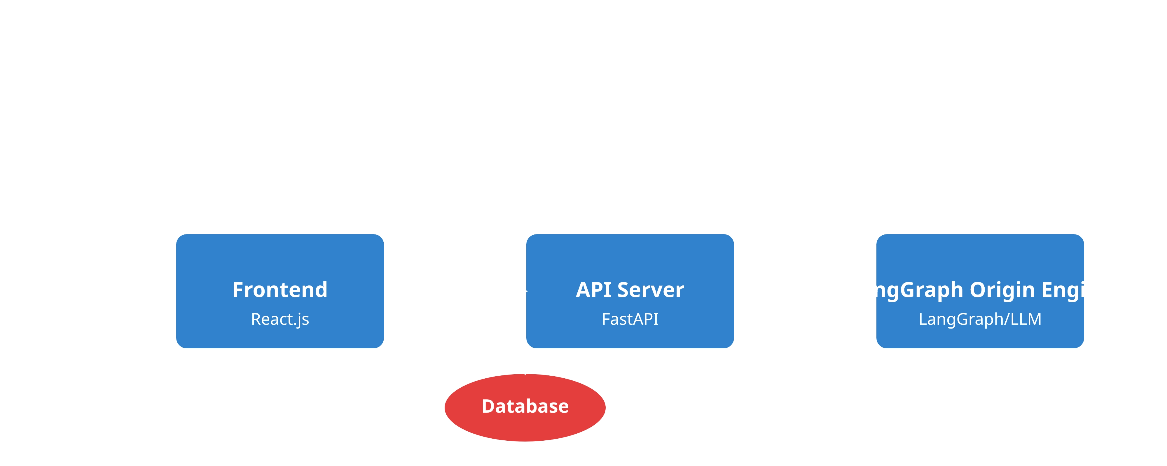
Architecture Overview
Frontend (React.js)
API Server (FastAPI)
LangGraph Origin Engine
User interface layer that provides interactive experience for users to manage products, calculate origins, and view reports.
Business logic layer that handles data management, authentication, and orchestrates communication between components.
AI-powered calculation engine that uses LLMs to analyze products, determine origins, and verify preferential status.

Slide 3
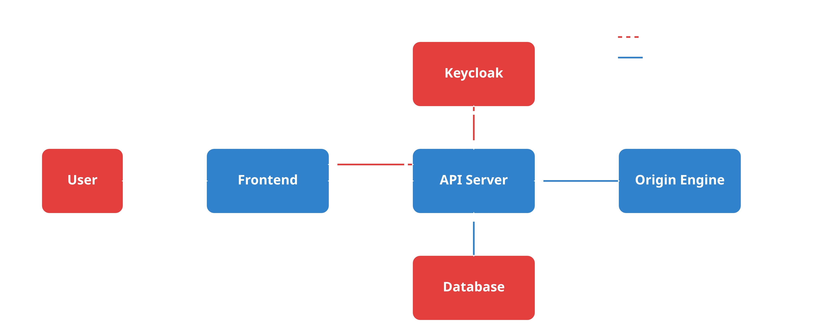
Communication Flow
User Interaction Flow
Authentication Flow
Origin Calculation Flow
User actions in the Frontend trigger API requests to the API Server, which processes the request and returns a response to update the UI.
JWT-based authentication with Keycloak integration for secure user authentication and authorization across all components.
Product data flows from Frontend to API Server to Origin Engine, which performs the calculation and returns the result through the same path.

Slide 4

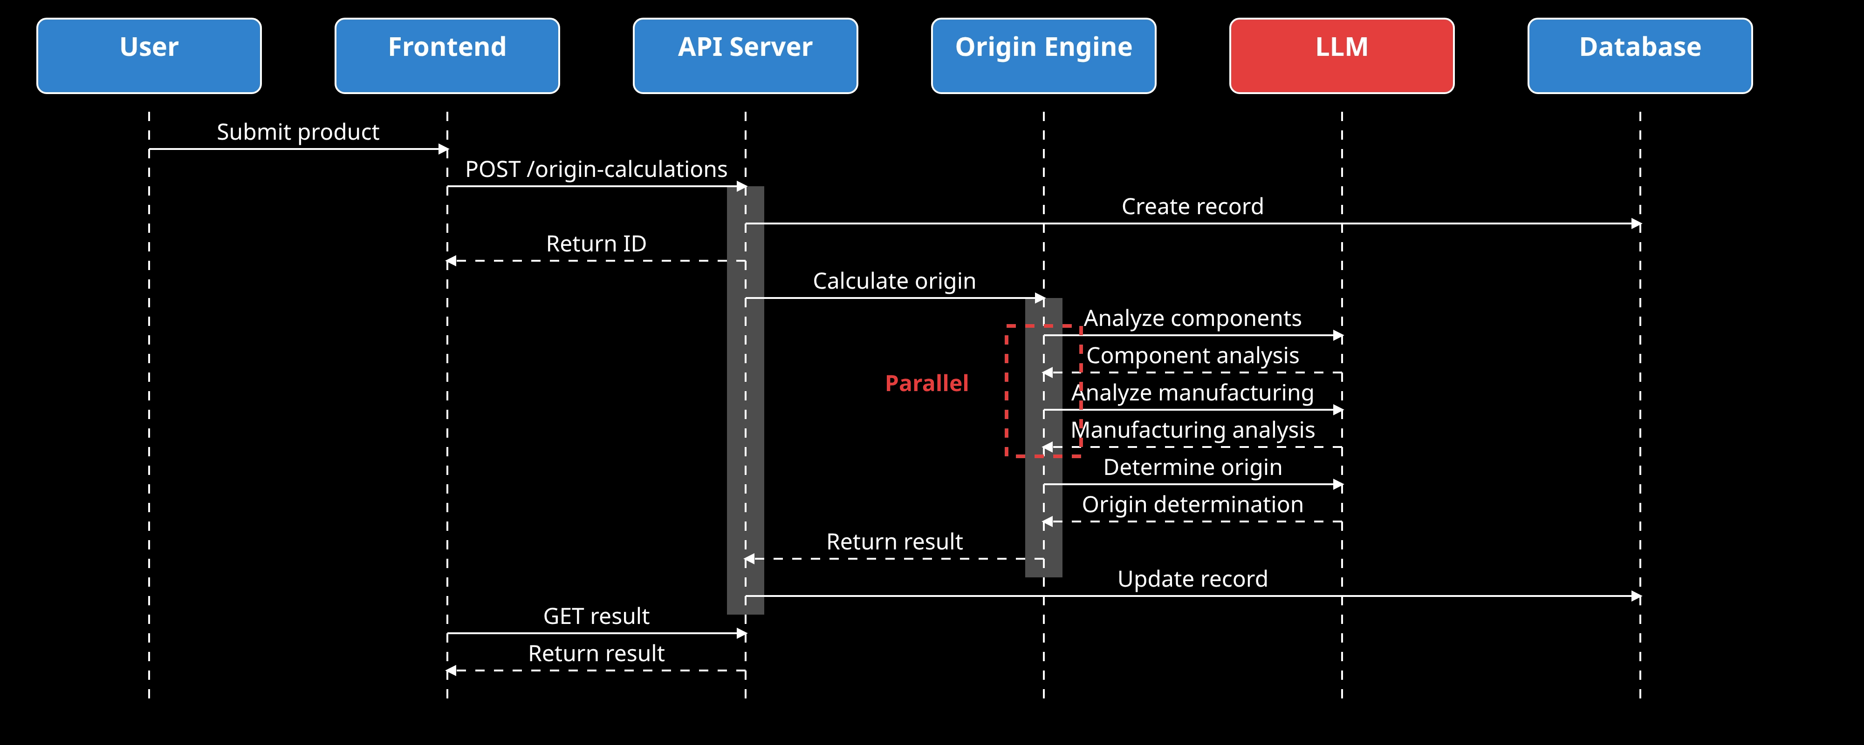
Origin Calculation Process
1
2
3
4
5
Component Analysis
Manufacturing Analysis
Origin Determination
Preferential Status
Report Generation
Analyze each component's origin and classification in parallel for optimal performance.
Apply trade rules to determine the final origin of the product.
Verify preferential status under applicable trade agreements.
Create comprehensive origin report with supporting evidence.
Evaluate manufacturing processes and their impact on product origin.

Slide 5

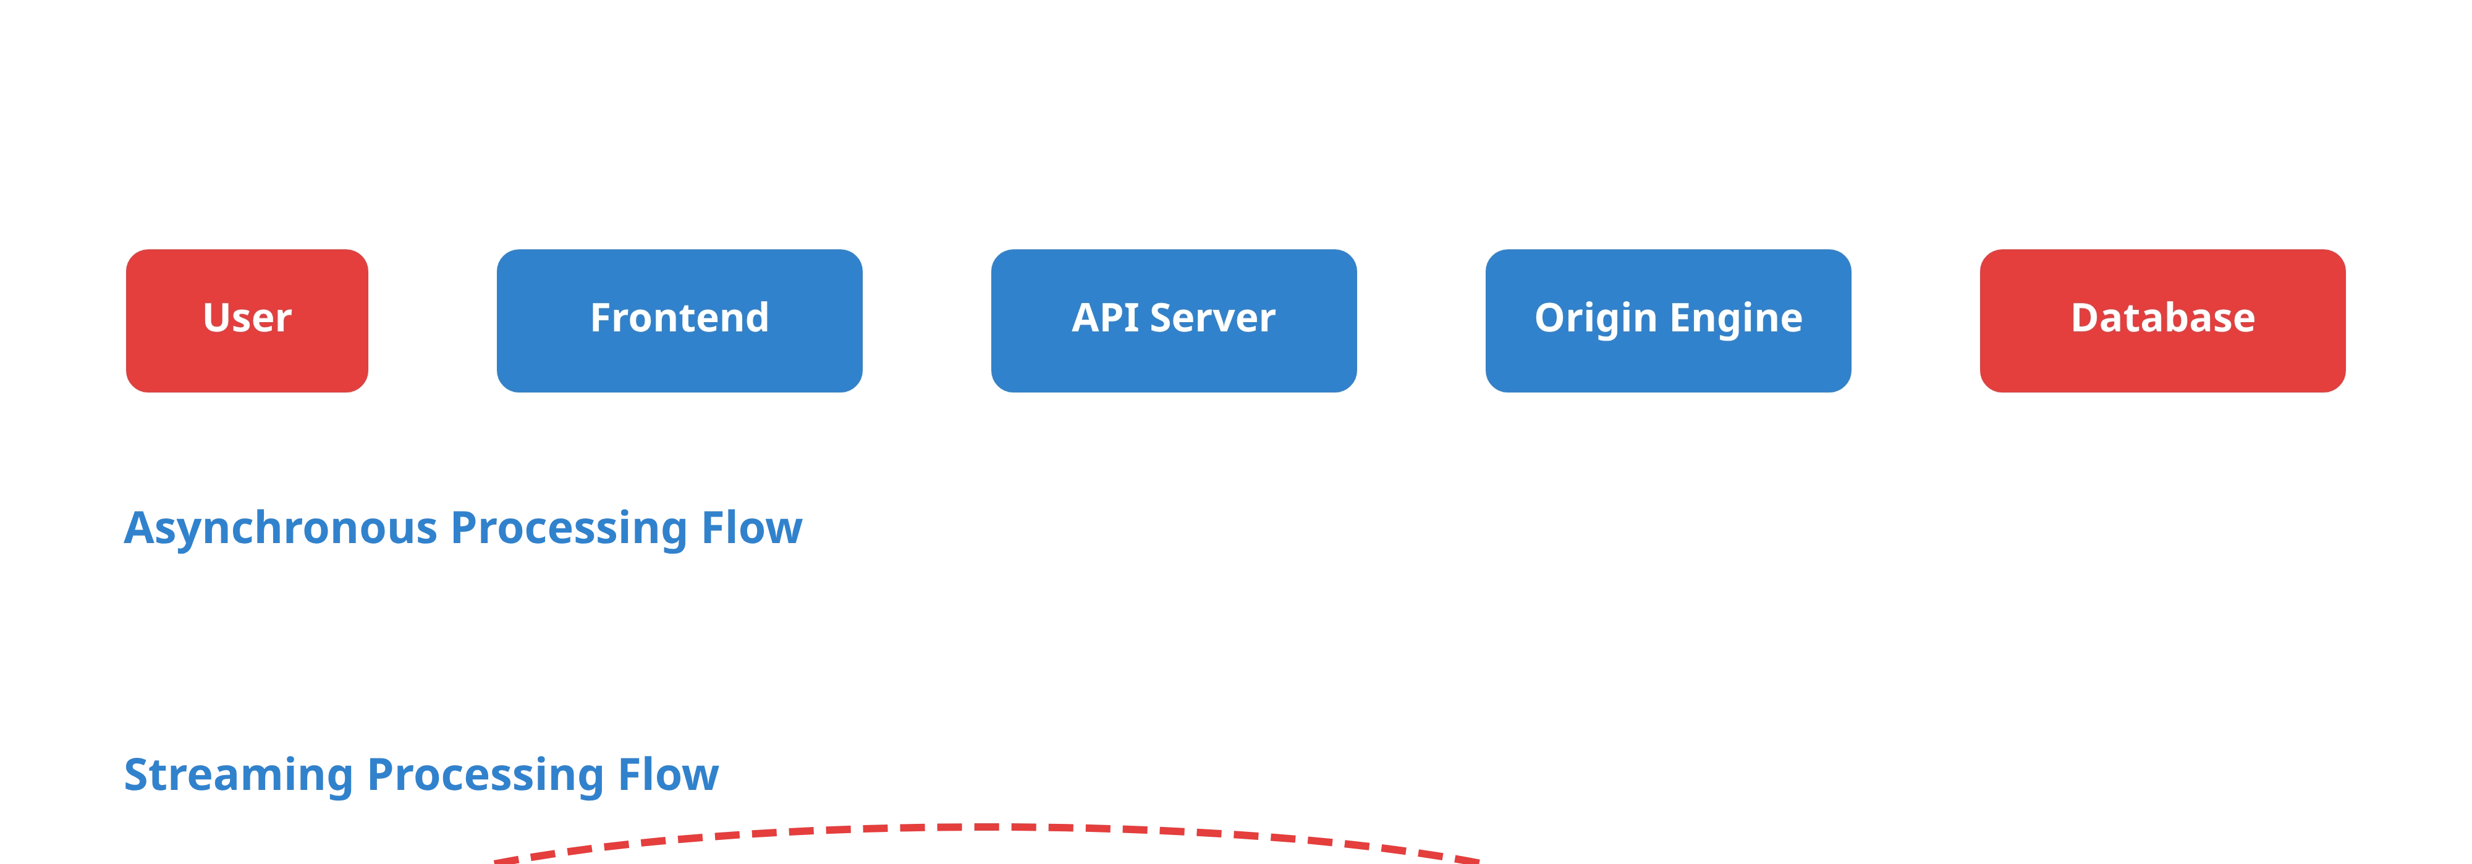

Asynchronous & Streaming Processing
Asynchronous Processing
Streaming Processing
For long-running calculations, the platform uses asynchronous processing to avoid blocking the user interface.
For complex calculations, the platform supports streaming updates to provide real-time feedback to users.
WebSocket or SSE connection
Calculation ID returned immediately
Real-time progress updates
Frontend polls for updates
Step-by-step calculation visibility
Result stored in database

Slide 6

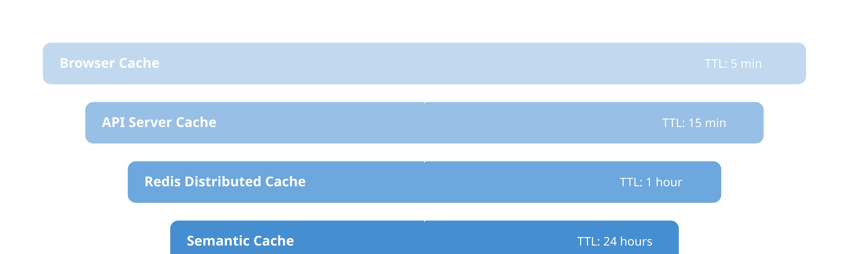
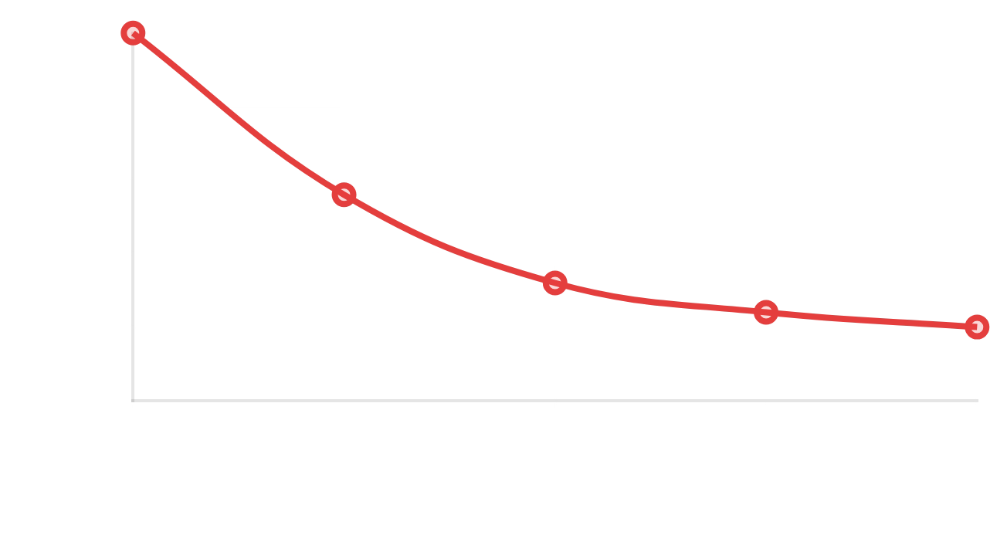
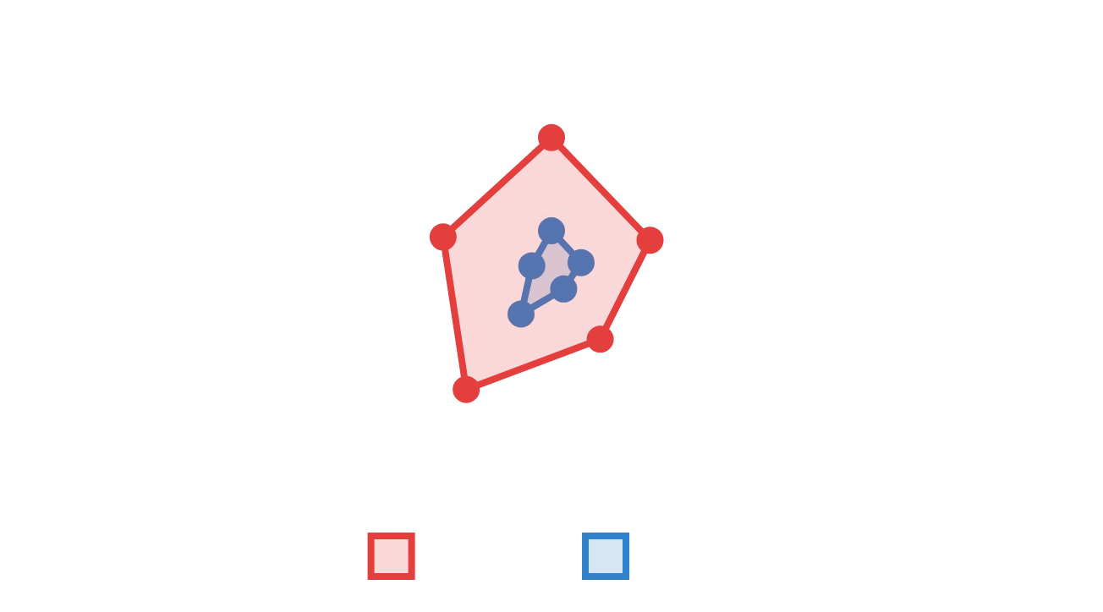
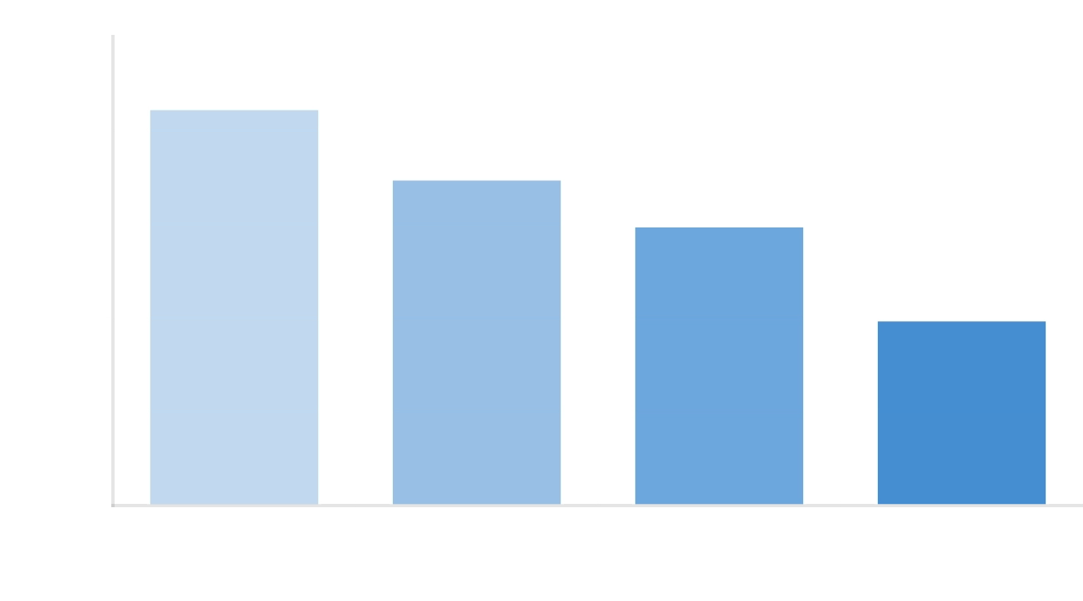
Caching & Performance Optimization
Multi-Level Caching
Parallel Processing
Resource Optimization
Hierarchical caching strategy with memory cache, Redis cache, and semantic cache for optimal performance.
Component analysis performed in parallel to reduce calculation time.
Efficient resource allocation with horizontal scaling based on demand.

Slide 7











Security & Monitoring
Security Measures
Monitoring & Observability
JWT-based authentication with Keycloak
Prometheus metrics collection
Role-based access control (RBAC)
Grafana dashboards for visualization
API key authentication for services
Structured logging with correlation IDs
Network micro-segmentation
Distributed tracing with OpenTelemetry
Data encryption at rest and in transit
Automated alerting for critical issues

Slide 8

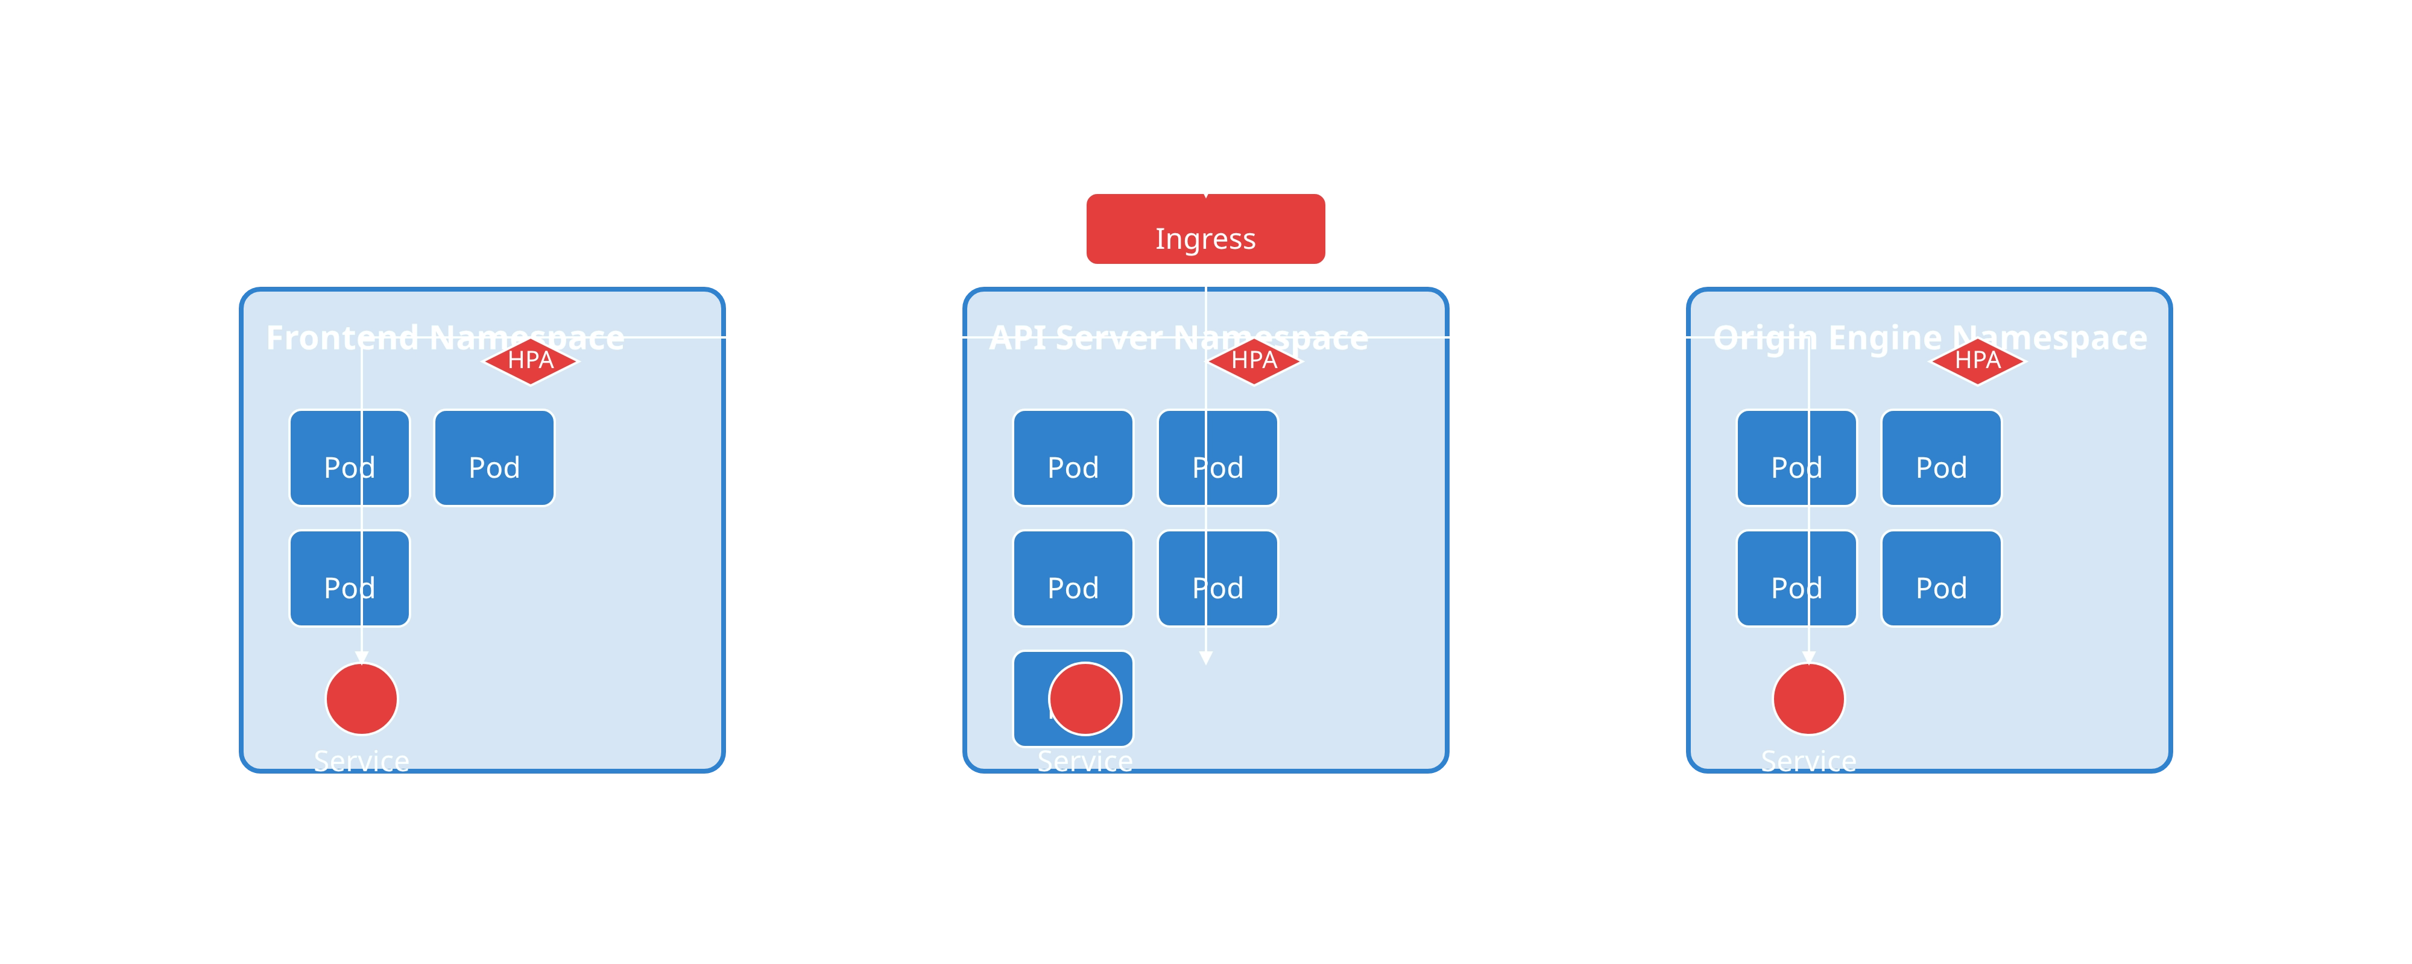
Deployment & Scaling
Frontend
API Server
Origin Engine
Static files served from CDN with multiple replicas for high availability. Horizontal scaling based on traffic patterns.
Multiple replicas with horizontal scaling based on CPU and memory usage. Database connection pooling for efficiency.
Multiple replicas with horizontal scaling based on calculation queue length. Resource limits for LLM inference.

Slide 9

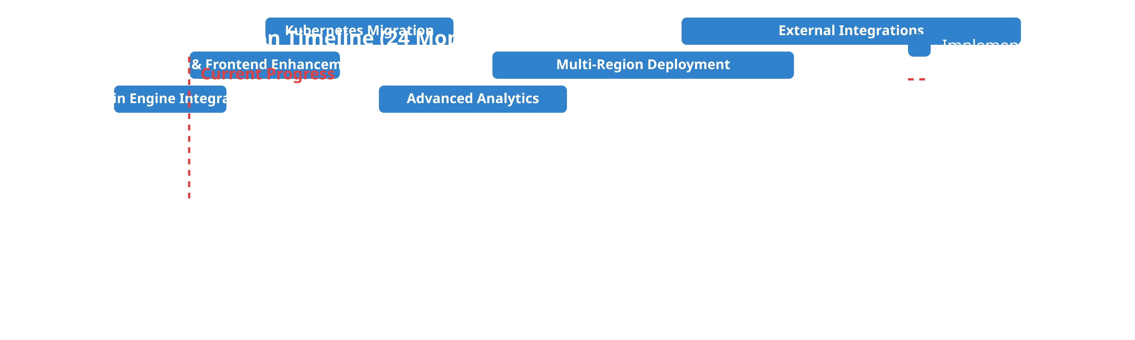







Next Steps & Implementation Timeline
Short-Term (1-3 months)
Medium-Term (4-9 months)
Long-Term (10-24 months)
Complete LangGraph Origin Engine integration
Migrate to Kubernetes for improved scalability
Implement multi-region deployment
Implement multi-level caching strategy
Implement distributed tracing with OpenTelemetry
Develop AI-powered predictive analytics
Deploy monitoring and alerting infrastructure
Enhance API with GraphQL for complex queries
Integrate with external trade compliance systems
Establish CI/CD pipeline for all components
Develop advanced analytics dashboard
Expand to additional trade agreement coverage

